Slide 1
SIBYL

Slide 2



Slide 3





Team Presentation
Jose Manuel
Fonseca
Santiago
Puerta
Miguel
Correa
Mauricio
Toro

Slide 4

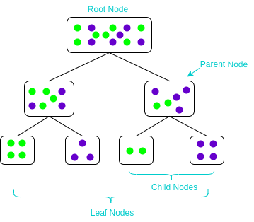
Algorithm Design
This image illustrates how a tree splits its nodes given the best variable that splits the data set. In our case this image shows how the tree would split the data set given certain condition.

Slide 5
Node Splitting
As an example, this split is based on the condition “city ==“Medellin”. For this case, left Gini impurity is 0.44, right Gini impurity is 0.32, and weigthed Gini impurity is 0.37.
As an example, this split is based on the condition “stratum == 4.” For this case, left Gini impurity is 0.44, right Gini impurity is 0.5, and weigthed Gini impurity is 0.45.

Slide 6


Algorithm Complexity
CART decision tree | Time Complexity | Memory Complexity
Training the model | O(v * m log(n)) | O(n)
Testing the Model | O(k) | O(1)
In the training “v” is the number of rows and “m” is the number of columns of the data matrix, in the testing section the “k” stands for the depth of the tree. In space “n” means the number of nodes in the tree.

Slide 7
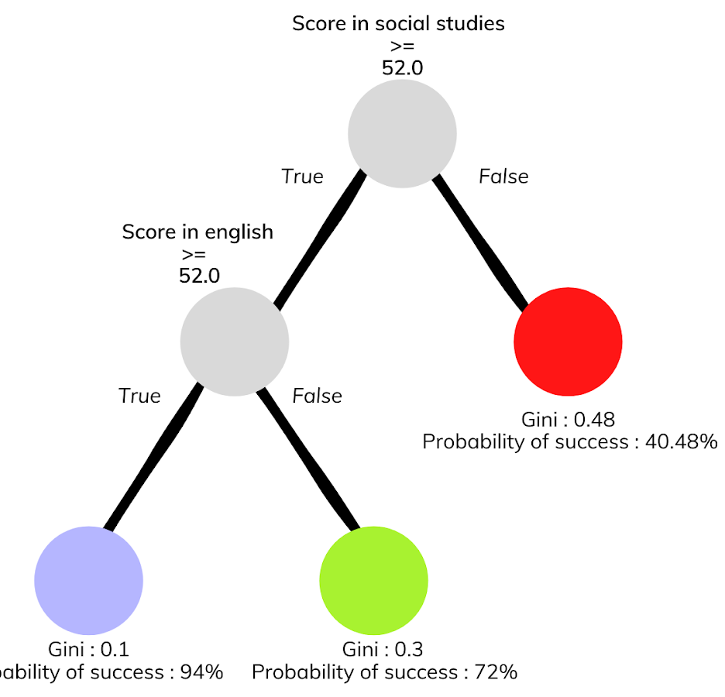


Decision-Tree Model
Most Relevant Feature
English
Fun Fact
The relevant features changes every time with random forest
A binary decision tree to predict Saber Pro scores based on the results of Saber 11. Violet nodes represent those with a high probability of success, green medium probability and red a low probability of success.

Slide 8
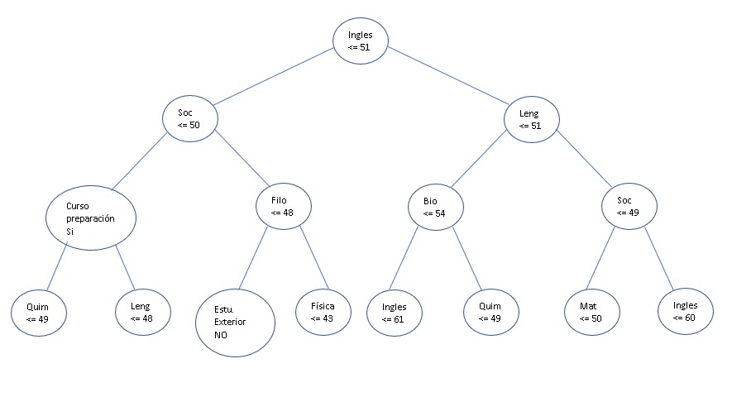

Slide 9
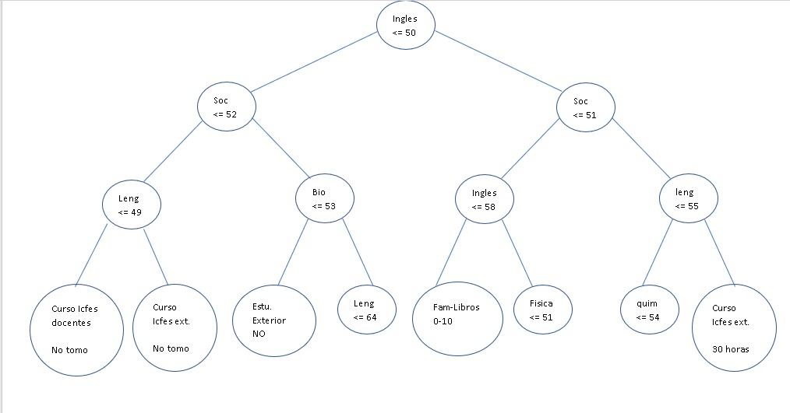

Slide 10
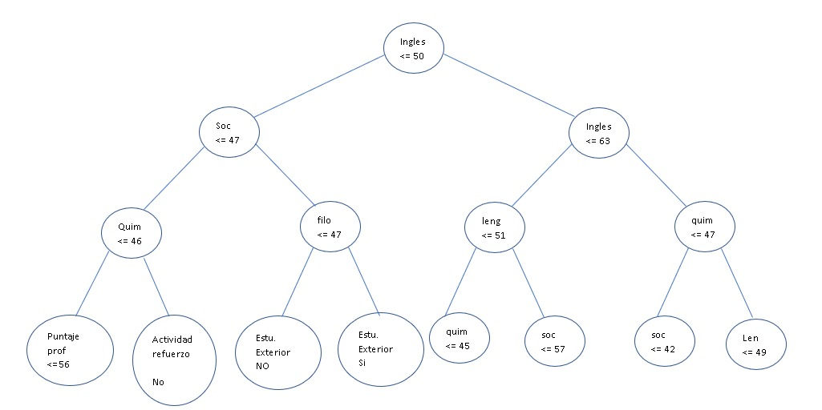

Slide 11



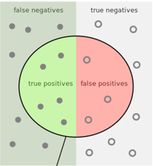
Evaluation Metrics
Accuracy =

Slide 12

Evaluation Metrics
 | Training data set | Testing data set
Accuracy | 0.85 | 0.8
Precision | 0.83 | 0.83
Recall | 0.76 | 0.73
Evaluation metrics using a training dataset of 135,000 students and test dataset of 45,000 students.

Slide 13


Time and Memory Consumption
Time Consumption
Memory Consumption

Slide 14


